Slide 1
Java homework Using the UI
Haneul, Artem

Slide 2
Plan
Character → UI
1: A robot(artem)and a bear(pet) appear in random locations.
2: For the first five seconds, the robot can be moved with the bear. The word “bear" appears at the bottom of the screen.
3: For the next five seconds, the robot can be moved with the WASD keys. The word “bear" appears at the bottom of the screen.
If the bear is caught before then, the screen will display "catch." After five seconds, the screen will reset to 1.

Slide 3
Step-by-step programming
Sprint 1: Draw the characters
Sprint 2: Move the characters
Sprint 3: interaction between characters
Sprint 4: time control

Slide 4
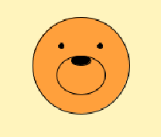
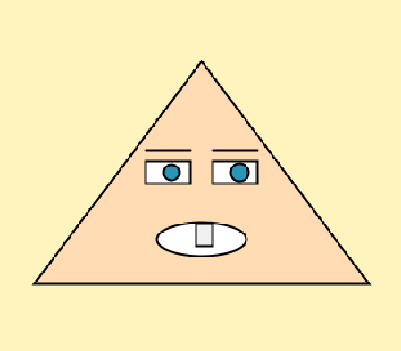
Sprint 1. drawing character
void setup() {
size(800, 600);
background(255,244,189);
// Haneul’s pet (слева)
pet(200, 300, 10);
// Artem’s character (справа)
artem(600, 300, 10);
}
void pet(float x,float y, float d){
fill(255,160,60);
circle(x,y,d*10); // face
ellipse(x,y+d,d*5,d*4); // muzzle
fill(0);
ellipse(x,y-0.5*d,d*2,d); // nose
circle(x+d*2,y-d*2,0.5*d); // right eye
circle(x-d*2,y-d*2,0.5*d); // left eye
}
void artem(float x, float y, float d){
fill(255,220,180);
strokeWeight(2);
triangle(x-15*d,y+20*d, x+15*d,y+20*d, x,y); // body
fill(255);
rect(x-5*d,y+9*d,4*d,2*d); // left eye
rect(x+1*d,y+9*d,4*d,2*d); // right eye
stroke(0);
line(x+1*d,y+8*d,x+5*d,y+8*d); // eyebrow right
line(x-5*d,y+8*d,x-1*d,y+8*d); // eyebrow left
fill(40,150,180);
circle(x-2.7*d,y+10*d,1.4*d); // pupil left
circle(x+3.4*d,y+10*d,1.6*d); // pupil right
fill(255);
ellipse(x,y+16*d,8*d,3*d); // mouth
fill(240);
rect(x-0.5*d,y+14.6*d,1.5*d,2*d); // tooth
}

Slide 5
Sprint 2. Move the characters
float x1,y1,x2,y2;
void setup()
{
size(800, 600);
x1 = random(width);
y1 = random(height);
x2 = random(width);
y2 = random(height);
}
void draw(){
background(255,244,189);
pet(x1,y1,10);
artem(x2,y2,5);
}
void mouseDragged()
{
x1=mouseX; y1= mouseY;
}
void keyPressed(){
if(key == 'w') y2 -= 2;
else if(key == 'a') x2 -= 2;
else if(key == 's') y2 += 2;
else if(key == 'd') x2 += 2;
}
void pet(float x,float y, float d){
fill(255,160,60);
circle(x,y,d*10); // face
ellipse(x,y+d,d*5,d*4); // muzzle
fill(0);
ellipse(x,y-0.5*d,d*2,d); // nose
circle(x+d*2,y-d*2,0.5*d); // right eye
circle(x-d*2,y-d*2,0.5*d); // left eye
}
void artem(float x, float y, float d){
fill(255,220,180);
strokeWeight(2);
triangle(x-15*d,y+20*d, x+15*d,y+20*d, x,y); // body
fill(255);
rect(x-5*d,y+9*d,4*d,2*d); // left eye
rect(x+1*d,y+9*d,4*d,2*d); // right eye
stroke(0);
line(x+1*d,y+8*d,x+5*d,y+8*d); // eyebrow right
line(x-5*d,y+8*d,x-1*d,y+8*d); // eyebrow left
fill(40,150,180);
circle(x-2.7*d,y+10*d,1.4*d); // pupil left
circle(x+3.4*d,y+10*d,1.6*d); // pupil right
fill(255);
ellipse(x,y+16*d,8*d,3*d); // mouth
fill(240);
rect(x-0.5*d,y+14.6*d,1.5*d,2*d); // tooth
}

Slide 6
Sprint 3. Catching mouse
If the distance between the robot and the bear is less than a certain amount, it is caught and we write “catch.” If it is not caught, we write “hurry up.”
// Sprint 3: Interaction between characters
float x1, y1, x2, y2;
boolean catched = false;
void setup() {
size(800, 600);
// Random starting positions
x1 = random(width);
y1 = random(height);
x2 = random(width);
y2 = random(height);
textSize(50);
textAlign(CENTER, CENTER);
}
void draw() {
background(255, 244, 189);
pet(x1, y1, 10);
artem(x2, y2, 5);
// Check if characters are close enough (caught)
if (dist(x1, y1, x2, y2) < 100) {
catched = true;
} else {
catched = false;
}
// Display message based on catch status
if (catched) {
fill(255, 0, 0); // Red
text("catch", width/2, height/2);
} else {
fill(0, 255, 0); // Green
text("hurry up", width/2, height/2);
}
}
void mouseDragged() {
x1 = mouseX;
y1 = mouseY;
}
void keyPressed() {
if (key == 'w' || key == 'W') y2 -= 3;
else if (key == 'a' || key == 'A') x2 -= 3;
else if (key == 's' || key == 'S') y2 += 3;
else if (key == 'd' || key == 'D') x2 += 3;
}
void pet(float x, float y, float d) {
fill(255, 160, 60);
circle(x, y, d*10); // face
ellipse(x, y+d, d*5, d*4); // muzzle
fill(0);
ellipse(x, y-0.5*d, d*2, d); // nose
circle(x+d*2, y-d*2, 0.5*d); // right eye
circle(x-d*2, y-d*2, 0.5*d); // left eye
}
void artem(float x, float y, float d) {
fill(255, 220, 180);
strokeWeight(2);
triangle(x-15*d, y+20*d, x+15*d, y+20*d, x, y); // body
fill(255);
rect(x-5*d, y+9*d, 4*d, 2*d); // left eye
rect(x+1*d, y+9*d, 4*d, 2*d); // right eye
stroke(0);
line(x+1*d, y+8*d, x+5*d, y+8*d); // eyebrow right
line(x-5*d, y+8*d, x-1*d, y+8*d); // eyebrow left
fill(40, 150, 180);
circle(x-2.7*d, y+10*d, 1.4*d); // pupil left
circle(x+3.4*d, y+10*d, 1.6*d); // pupil right
fill(255);
ellipse(x, y+16*d, 8*d, 3*d); // mouth
fill(240);
rect(x-0.5*d, y+14.6*d, 1.5*d, 2*d); // tooth
}

Slide 7
Sprint 4. It operates according to time and condition.
There are two states: bear state and robot state (caught state, not caught state).
// Sprint 4: Time control
float x1, y1, x2, y2;
boolean catched = false;
int timer = 0;
void setup() {
size(800, 600);
// Random starting positions
x1 = random(width);
y1 = random(height);
x2 = random(width);
y2 = random(height);
textSize(50);
textAlign(CENTER, CENTER);
}
void draw() {
timer++;
background(255, 244, 189);
pet(x1, y1, 10);
artem(x2, y2, 5);
// Check if characters are close enough (caught)
if (dist(x1, y1, x2, y2) < 100) {
catched = true;
} else {
catched = false;
}
// Display message based on catch status
if (catched) {
fill(255, 0, 0); // Red
text("catch", width/2, height/2);
} else {
fill(0, 255, 0); // Green
text("hurry up", width/2, height/2);
}
// Display character name at bottom based on time
fill(0, 0, 255); // Blue
if (timer < 5*frameRate) {
text("bear", 100, height-50);
} else if (timer < 10*frameRate) {
text("robot", 100, height-50);
} else {
timer = 0; // Reset timer after 10 seconds
}
}
void mouseDragged() {
// Only move bear during first 5 seconds
if (timer < 5*frameRate) {
x1 = mouseX;
y1 = mouseY;
}
}
void keyPressed() {
// Only move robot during seconds 5-10
if (timer >= 5*frameRate && timer < 10*frameRate) {
if (key == 'w' || key == 'W') y2 -= 3;
else if (key == 'a' || key == 'A') x2 -= 3;
else if (key == 's' || key == 'S') y2 += 3;
else if (key == 'd' || key == 'D') x2 += 3;
}
}
void pet(float x, float y, float d) {
fill(255, 160, 60);
circle(x, y, d*10); // face
ellipse(x, y+d, d*5, d*4); // muzzle
fill(0);
ellipse(x, y-0.5*d, d*2, d); // nose
circle(x+d*2, y-d*2, 0.5*d); // right eye
circle(x-d*2, y-d*2, 0.5*d); // left eye
}
void artem(float x, float y, float d) {
fill(255, 220, 180);
strokeWeight(2);
triangle(x-15*d, y+20*d, x+15*d, y+20*d, x, y); // body
fill(255);
rect(x-5*d, y+9*d, 4*d, 2*d); // left eye
rect(x+1*d, y+9*d, 4*d, 2*d); // right eye
stroke(0);
line(x+1*d, y+8*d, x+5*d, y+8*d); // eyebrow right
line(x-5*d, y+8*d, x-1*d, y+8*d); // eyebrow left
fill(40, 150, 180);
circle(x-2.7*d, y+10*d, 1.4*d); // pupil left
circle(x+3.4*d, y+10*d, 1.6*d); // pupil right
fill(255);
ellipse(x, y+16*d, 8*d, 3*d); // mouth
fill(240);
rect(x-0.5*d, y+14.6*d, 1.5*d, 2*d); // tooth
}

Slide 8
Final version
float x1, y1, x2, y2;
boolean catched = false;
boolean wasCaught = false; // Flag to track if already caught
int timer = 0;
int score = 0; // Score counter
void setup() {
size(800, 600);
// Random starting positions
x1 = random(width);
y1 = random(height);
x2 = random(width);
y2 = random(height);
textSize(50);
textAlign(CENTER, CENTER);
}
void draw() {
timer++;
background(255, 244, 189);
pet(x1, y1, 10);
artem(x2, y2, 5);
// Check distance and update catch status
if (dist(x1, y1, x2, y2) < 100) {
catched = true;
if (!wasCaught) { // If just caught, increase score once
score++;
wasCaught = true;
}
} else {
catched = false;
wasCaught = false; // Reset flag when not caught
}
// Display score in top left corner
fill(0);
textSize(30);
textAlign(LEFT, TOP);
text("Score: " + score, 20, 20);
// Reset text settings for center text
textSize(50);
textAlign(CENTER, CENTER);
// Display message based on catch status
if (catched) {
fill(255, 0, 0); // Red
text("catch", width/2, height/2);
} else {
fill(0, 255, 0); // Green
text("hurry up", width/2, height/2);
}
// Display character name at bottom based on time
fill(0, 0, 255); // Blue
if (timer < 5*frameRate) {
text("bear", 100, height-50);
} else if (timer < 10*frameRate) {
text("robot", 100, height-50);
} else {
timer = 0; // Reset timer after 10 seconds
}
}
void mouseDragged() {
// Only move bear during first 5 seconds
if (timer < 5*frameRate) {
float speed = 0.05; // Bear movement speed (adjustable: 0.01-1.0)
x1 += (mouseX - x1) * speed;
y1 += (mouseY - y1) * speed;
}
}
void keyPressed() {
// Only move robot during seconds 5-10
if (timer >= 5*frameRate && timer < 10*frameRate) {
float robotSpeed = 10; // Robot movement speed (adjustable)
if (key == 'w' || key == 'W') y2 -= robotSpeed; // Move up
else if (key == 'a' || key == 'A') x2 -= robotSpeed; // Move left
else if (key == 's' || key == 'S') y2 += robotSpeed; // Move down
else if (key == 'd' || key == 'D') x2 += robotSpeed; // Move right
}
}
void pet(float x, float y, float d) { // Bear character
fill(255, 160, 60);
circle(x, y, d*10); // face
ellipse(x, y+d, d*5, d*4); // muzzle
fill(0);
ellipse(x, y-0.5*d, d*2, d); // nose
circle(x+d*2, y-d*2, 0.5*d); // right eye
circle(x-d*2, y-d*2, 0.5*d); // left eye
}
void artem(float x, float y, float d) { // Robot character
fill(255, 220, 180);
strokeWeight(2);
triangle(x-15*d, y+20*d, x+15*d, y+20*d, x, y); // body
fill(255);
rect(x-5*d, y+9*d, 4*d, 2*d); // left eye
rect(x+1*d, y+9*d, 4*d, 2*d); // right eye
stroke(0);
line(x+1*d, y+8*d, x+5*d, y+8*d); // eyebrow right
line(x-5*d, y+8*d, x-1*d, y+8*d); // eyebrow left
fill(40, 150, 180);
circle(x-2.7*d, y+10*d, 1.4*d); // pupil left
circle(x+3.4*d, y+10*d, 1.6*d); // pupil right
fill(255);
ellipse(x, y+16*d, 8*d, 3*d); // mouth
fill(240);
rect(x-0.5*d, y+14.6*d, 1.5*d, 2*d); // tooth
}

Slide 9
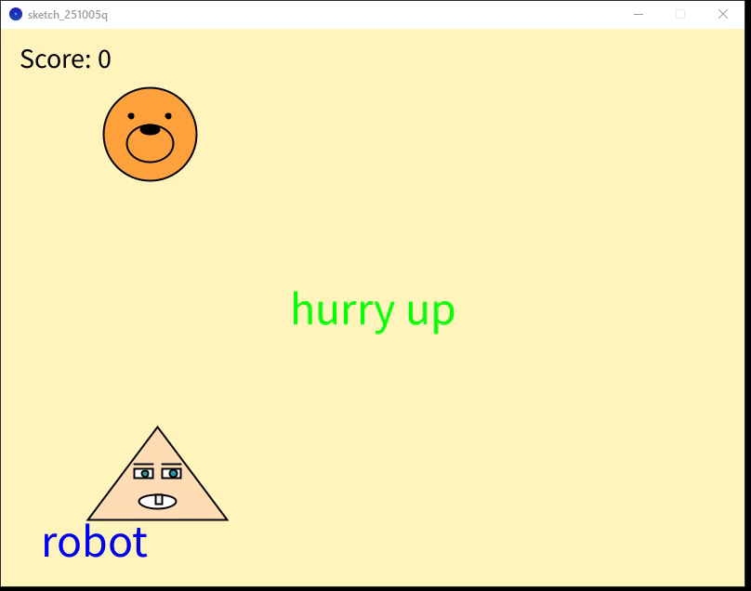

Slide 10
Impressions on completing the assignment
Haneul: It was interesting to watch our characters. My pet moves with the mouse, and Artem's character moves with the keyboard.
Artem: It was enjoyable to see how the two characters interact with each other. I worked on implementing the time-based control system and the score counter, which made the game more challenging and fun to play.

Slide 11
Extra
Score counter system - Displays in the top-left corner and tracks successful catches
Modified movement speeds:
Bear: Smooth following movement (speed = 0.005) instead of instant positioning
Robot: Adjusted keyboard movement speed (10 pixels per keypress)
Proper catch detection logic - Using wasCaught flag to prevent score from incrementing multiple times during a single catch.
These additions improved the gameplay experience and made the interaction between characters more engaging.

Slide 12
All source code
The full project is uploaded to GitHub: https://github.com/brevno-project/Java

